Slide 1



UNIT 3
LESSON 11
Crazy about sports
Part 2

Slide 2
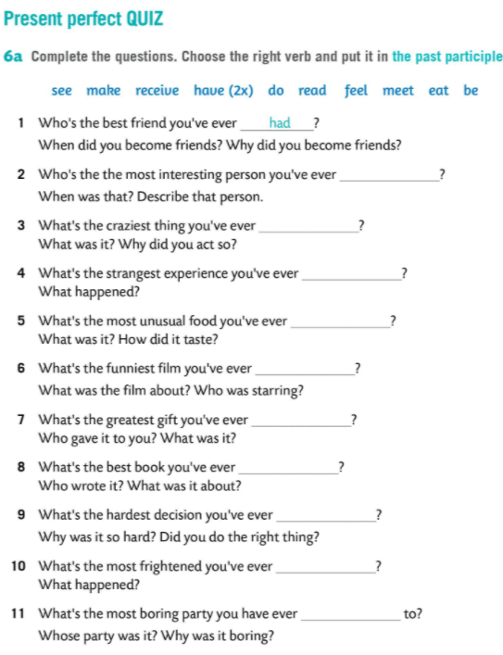
met
Report to the whole class on the most interesting things you have heard from your partner.
done
had
eaten
seen
received
read
Have you ever done any extreme sports?
made
felt
been

Slide 3
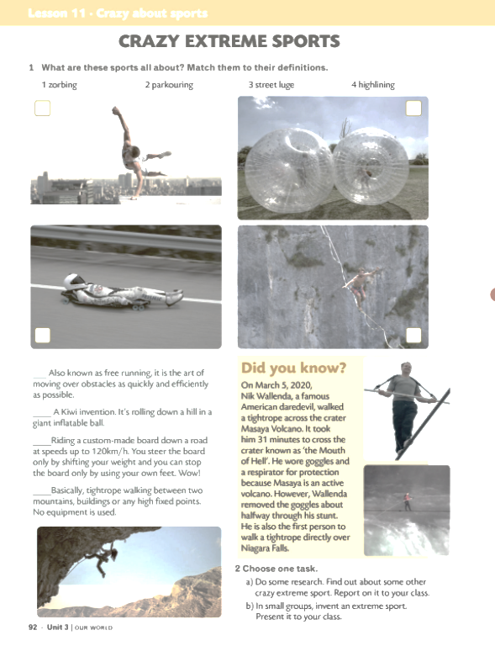
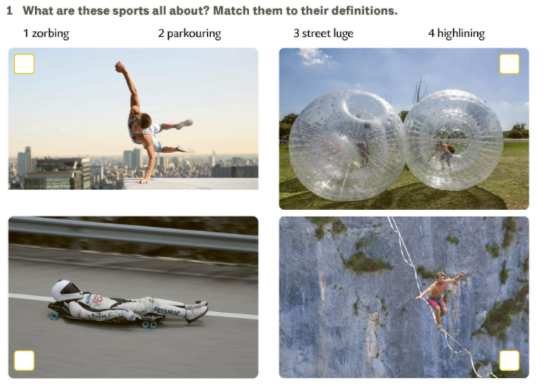
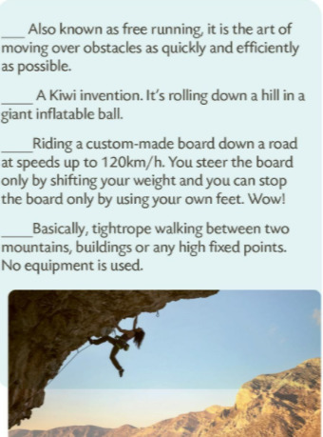
2
1
2
1
3
4
3
4
Which of the sports discussed do you find the most interesting/dangerous/funniest?

Slide 4
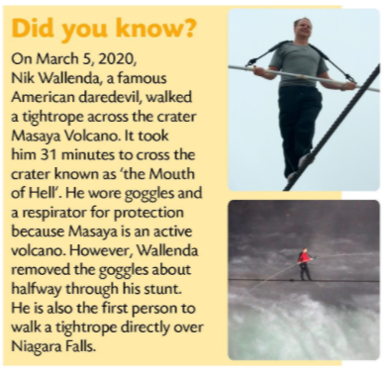
break
enroll
win
afford
be
plan
sign
a contract
a record
a championship
expensive gear
at a college
physically and mentally fit
a diet
sign a contract
win a championship
afford expensive gear
plan a diet
break a record
enroll at a college
be physically and mentally fit
potpisati ugovor
osvojiti prvenstvo
priuštiti skupu opremu
planirati prehranu
What do you think about it?
oboriti rekord
upisati fakultet
What do you associate the words/expressions with?
biti u fizičkoj i mentalnoj dobroj spremi

Slide 5
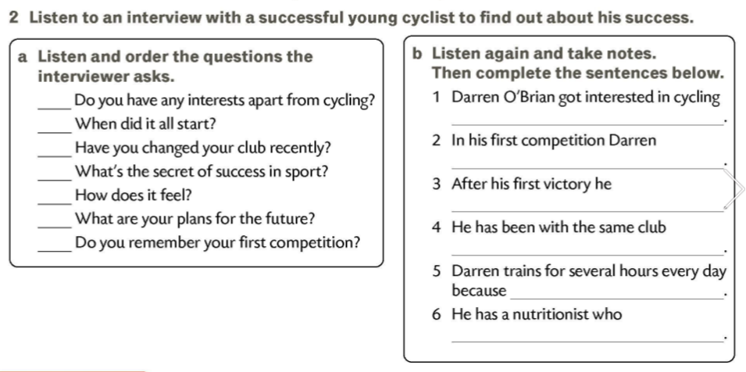
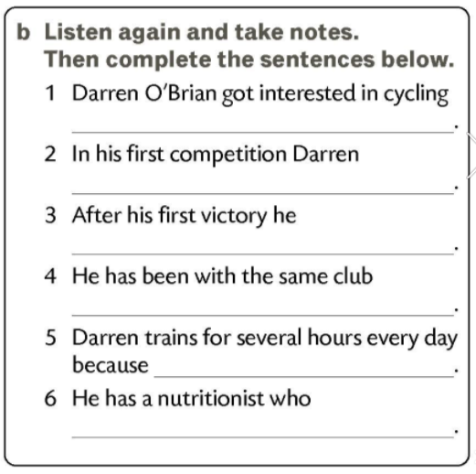
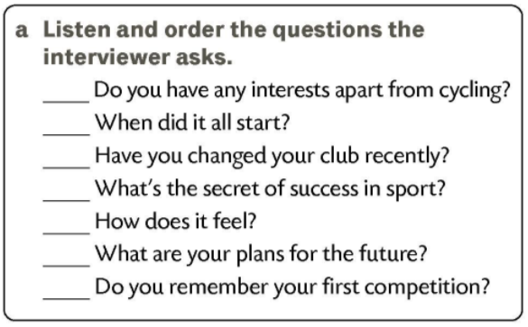

‘ON TOP OF THE WORLD’
10 years ago.
6
2
won the race.
4
was offered a contract with the local cycling club.
5
1
for 10 years.
7
3
it’s important to be physically fit.
plans his diet carefully.

Slide 6
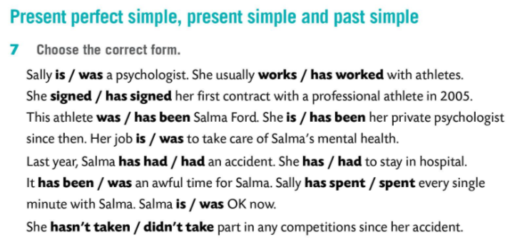
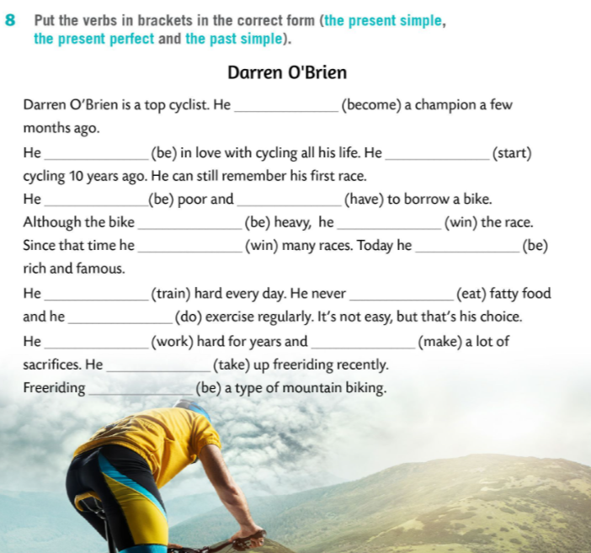
became
has been
started
was
had
was
won
has won
is
trains
eats
does
has worked
has made
has taken
is

Slide 7
